Slide 1
MODULRE: SWDJF301 MODULE: JAVASCRIPT FUNDAMENTALS

Slide 2
Learning Outcome 1: Apply JavaScript Basic Concepts Indicative content 1.1: Introduction to JavaScript
Definition of JAVASCRIPT
JavaScript is a lightweight programming language that web developers commonly use to create more dynamic interactions when developing web pages, applications, servers, and or even games.
Application of Javascript
JavaScript is widely used for building websites and web applications. Let’s discuss some practical applications of JavaScript in various segments.

Slide 3
Cont’
1. Web Development
JavaScript is a scripting language used to develop web pages.
Some famous websites built by the use of JavaScript are Google, YouTube, Facebook, Wikipedia, Yahoo, Amazon, eBay, Twitter, and LinkedIn, to name a few.

Slide 4
Cont’
2. Presentations
A very popular application of JavaScript is to create interactive presentations as websites. The RevealJs and BespokeJs libraries can be used to generate web-based slide decks using HTML.
3. Server Applications
JavaScript is also used to write server-side software through Node.js open-source runtime environment. Developers can write, test and debug code for fast and scalable network applications.

Slide 5
4. Web Servers
Node.js allows developers to use JavaScript to create a web server.
Games
Creating games on the web is another important one among applications of JavaScript. The combination of JavaScript and HTML5 plays a major role in games development using JS. The EaselJS library provides rich graphics for games.

Slide 6
Cont’
2. Art
A recent feature of HTML5 in JavaScript is the canvas element, which allows drawing 2D and 3D graphics easily on a web page.
3. Smartwatch Apps
Pebble.js is a JavaScript framework by Pebble, allowing developers to create applications for Pebble watches using JavaScript. Create a smartwatch app with simple JavaScript code.

Slide 7
4. Mobile Apps
One of the most powerful applications of JavaScript is to create apps for non-web contexts, meaning for things, not on the Internet. With the use of mobile devices at an all-time high, JavaScript frameworks have been designed to facilitate mobile app development across various platforms like IOS, Android, and Windows. React Native framework allows cross-platform mobile app building, where developers can use a universal front end for Android and IOS platforms.

Slide 8
Cont’
Flying Robots
Last but not least, you can use JavaScript to program a flying robot. With the Node.js ecosystem, users can control numerous small robots, creative maker projects, and IoT devices. Step into the exciting world of drones, flying robots, and quadcopters with JavaScript.
VSCode & node.js

Slide 9
Visual Studio Code is a free, lightweight but powerful source code editor that runs on your desktop and on the web and is available for Windows, macOS, Linux, and Raspberry Pi OS.
Visual Studio Code(VS Code) has support for many languages, including Python, Java, C++, JavaScript, and more
Node. js (Node) is an open source, cross-platform runtime environment for executing JavaScript code.

Slide 10
JAVASCRIPT key concepts
Variable
A JavaScript variable is simply a name of a storage location.
Four Ways to Declare a JavaScript Variable:
Using var
Using let
Using const
Using nothing

Slide 11
var: This keyword is used to declare variable globally.
Syntax: var variableName = "Variable-Value";
let: This keyword is used to declare variable locally.
Syntax: let variableName = "Variable-Value";

Slide 12
Cont’
Const: This keyword is used to declare variable locally.
Syntax: const variableName = "Variable-Value";
NOTE: Variables are classified into Global variables and Local variables based on their scope.
The main difference between Global and local variables is that global variables can be accessed globally in the entire program, whereas local variables can be accessed only within the function or block in which they are defined.

Slide 13
JavaScript Identifiers
All JavaScript variables must be identified with unique names.These unique names are called identifiers.
Identifiers can be short names (like x and y) or more descriptive names (age, sum, totalVolume).

Slide 14
Cont’
The general rules for constructing names for variables (unique identifiers) are:
Names can contain letters, digits, underscores, and dollar signs.
Names must begin with a letter.
Names can also begin with $ and _ (but we will not use it in this tutorial).
Names are case sensitive (y and Y are different variables).
Reserved words (like JavaScript keywords) cannot be used as names.

Slide 15
Data Types
Data types describe the different types or kinds of data that we're gonna be working with and storing in variables.
JavaScript provides different data types to hold different types of values. There are two types of data types in JavaScript.
Primitive data type
Non-primitive (reference) data type

Slide 16
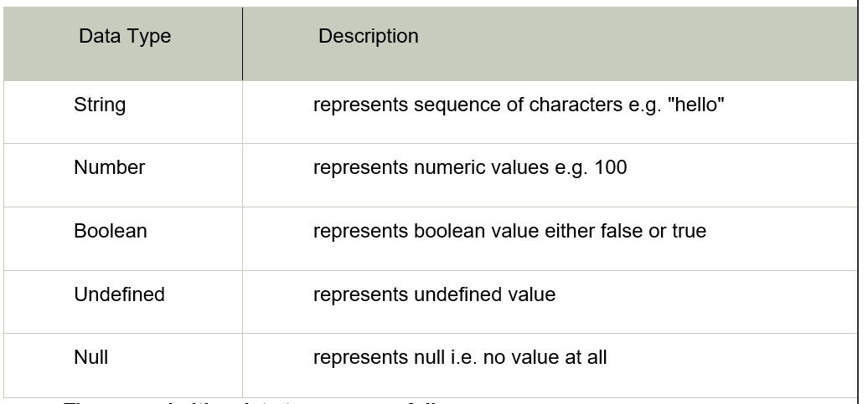
Cont’
There are five types of primitive data types in JavaScript. They are as follows:

Slide 17
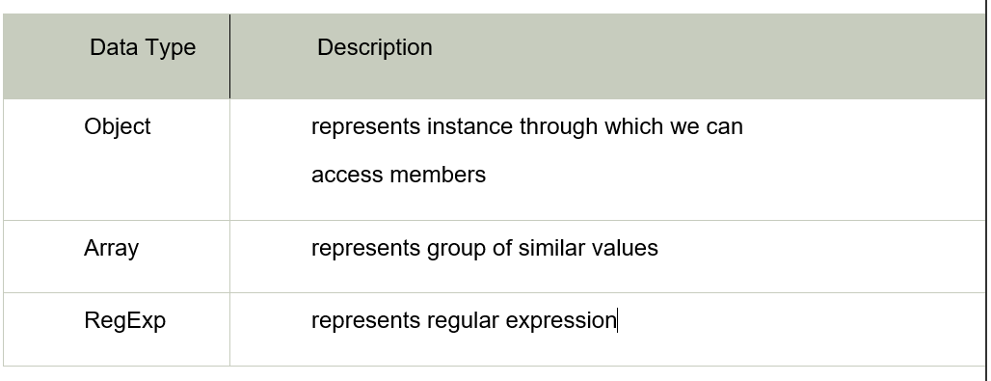
Cont’
The non-primitive data types are as follows:

Slide 18
Cont’
Values
A value is the representation of some entity that can be manipulated by a program. The members of a type are the values of that type. The "value of a variable" is given by the corresponding mapping in the environment.
JavaScript values are the values that comprise values like Booleans, Strings, arrays, numbers, etc.
Operators
In JavaScript, an operator is a special symbol used to perform operations on operands (values and variables). For example, 2 + 3.
Expressions
JavaScript's expression is a valid set of literals, variables, operators, and expressions that evaluate to a single value.

Slide 19
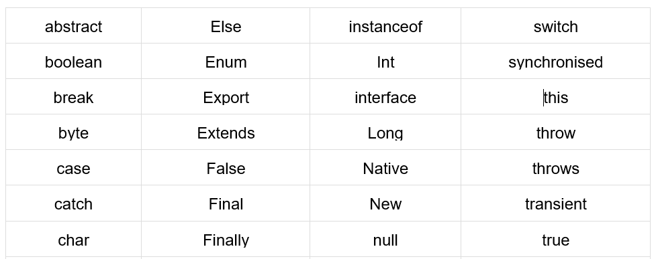
Cont’
Keywords
In JavaScripts keywords are reserved words that have a specific purpose and are already defined in the language.
A list of all the reserved words in JavaScript are given in the following table. They cannot be used as JavaScript variables, functions, methods, loop labels, or any object names.

Slide 20
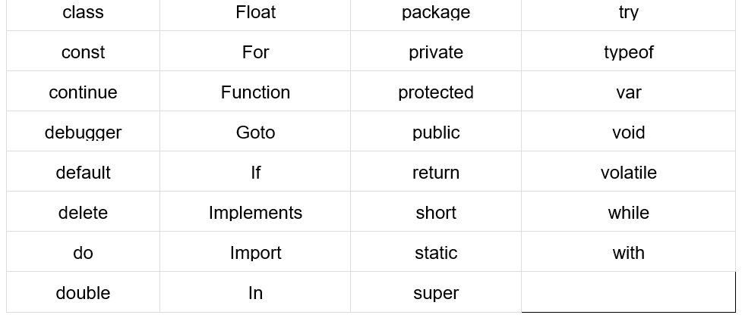
Cont’

Slide 21
Cont’
Comments
The JavaScript comments can be used to explain JavaScript code, and to make it more readable.
It is used to add information about the code, warnings or suggestions so that end users can easily interpret the code.
The JavaScript comment is ignored by the JavaScript engine

Slide 22
Advantages of JavaScript comments
There are mainly two main advantages of JavaScript comments.
To make code easy to understand It can be used to elaborate the code so that end users can easily understand the code.
To avoid unnecessary code It can also be used to avoid the code being executed. Sometimes, we add the code to perform some action. But after some time, the code may need to be disabled. In such cases, it is better to use comments.

Slide 23
Types of JavaScript Comments
There are two types of comments in JavaScript.
Single-line Comment
Multi-line Comment
Single Line Comments
Single-line comments start with //.
Any text between // and the end of the line will be ignored by JavaScript (will not be executed).

Slide 24
Example:
var x; //Declaration of a variable x
2. Multi-line Comments
Multi-line comments start with /* and end with */.
Any text between /* and */ will be ignored by JavaScript.
Example:
result=6*5; /* multiply two numbers and store the3
output in a variable called result*/

Slide 25
Javascript libraries
Javascript libraries is a file that contains a set of prewritten functions or codes that you can repeatedly use while executing JavaScript tasks.
React Javascript
React (also known as React.js or ReactJS) is a free and open-source front-end JavaScript library for building user interfaces based on UI components.

Slide 26
JQuery
It's a library of JavaScript functions that make it easy for web page developers to do common tasks-- like manipulating the webpage, responding to user events, getting data from their servers, building effects and animations, and much more.
Three Javascript
Three.js is a cross-browser JavaScript library and application programming interface (API) used to create and display animated 3D computer graphics in a web.

Slide 27
Javascript frameworks
A JavaScript framework is a set of JavaScript code libraries that provide pre-written code for everyday programming tasks to a web developer.
Vue Javascript
Vue.js is an open-source progressive JavaScript framework used to develop interactive web user interfaces and single-page applications (SPAs).

Slide 28
Angular Javascript
AngularJS is a client side JavaScript MVC framework to develop a dynamic web application.
Express Javascript
Express is a minimal and flexible Node.js web application framework that provides a robust set of features for web and mobile applications.

Slide 29
Javascript runtime environment
The JavaScript runtime environment provides access to built-in libraries and objects that are available to a program so that it can interact with the outside world and make the code work.
A JavaScript engine is a software component that executes JavaScript code.
Node Javascript
v8 Engine

Slide 30
Javascript versions
JavaScript was invented by Brendan Eich in 1995, and became an ECMA standard in 1997.
ECMAScript is the official name of the language.
ECMAScript versions have been abbreviated to ES1, ES2, ES3, ES5, and ES6.
Since 2016, versions are named by year (ECMAScript 2016, 2017, 2018, 2019, 2020).

Slide 31
Indicative content 1.2: Integration of Javascript to HTML
1.2.1: Explain how Javascript can be integrated to HTML
JavaScript, abbreviated to JS, is a programming language used in web development. As one of the core technologies of the web alongside HTML and CSS, JavaScript is used to make webpages interactive and to build web apps. Modern web browsers adhere to common display standards and support JavaScript through built-in engines without additional plugins.

Slide 32
Cont’
When working with files for the web, JavaScript needs to be loaded and run alongside HTML markup. This can be done either inline within an HTML document or in a separate file that the browser will download alongside the HTML document.
✔ Referencing HTML to JavaScript
To include an external JavaScript file, we can use the script tag with the attribute src.
The src attribute specifies the URL of an external script file.

Slide 33
If you want to run the same JavaScript on several pages in a website, you should create an external JavaScript file, instead of writing the same script over and over again. Save the script file with a .js extension, and then refer to it using the src attribute in the <script> tag.
Note: The external script file cannot contain the <script> tag.
✔ <script> tag
The <script> tag is used to embed a client-side script (JavaScript).

Slide 34
Example:
<script type="text/javascript">
document.write("PHPTPOINT is the place to study javascript easily");
</script>
Using the script tag signifies that we are using JavaScript
✔External JavaScript
With JavaScript, an external JavaScript file can be created and can easily be embedded into many HTML pages. Since a single JavaScript file can be used in various HTML pages hence, it provides code reusability.

Slide 35
In order to save a JavaScript file, .js extension must be used. To increase the speed of the webpages, it is recommended to embed the entire JavaScript file into a single file.
✔ Using external Javascript reference (CDN)
What is a CDN?
A CDN is a Content Delivery Network. These are file hosting services for multiple versions of common libraries.

Slide 36
You can use external JavaScript references, often referred to as Content Delivery Network (CDN) links, to include JavaScript libraries or scripts in your HTML documents. This is a common practice to save bandwidth and improve loading times. Here's how you can do it:
Find the CDN link for the JavaScript library you want to include. Many popular libraries like jQuery, Bootstrap, or React have CDN links available. These links are hosted on servers provided by various content delivery networks.

Slide 37
In your HTML document, add a <script> tag with the src attribute set to the CDN link.
By using CDN links, you can easily include external JavaScript libraries in your web pages without having to host the library files on your server, and your users will benefit from faster loading times since CDNs are designed for efficient content delivery.
✔ JavaScript output
JavaScript can "display" data in different ways:

Slide 38
Writing into an HTML element, using innerHTML.
Writing into the HTML output using a document. Write().
Writing into an alert box, using a window. alert().
Writing into the browser console, using console.log ().
1.2.2: Integrate Javascript to HTML
✔ Referencing HTML to JavaScript

Slide 39
Example:
<!DOCTYPE html>
<html>
<body>
<h1>The script src attribute</h1>
<script src="demo_script_src.js">
</script>
</body>
</html>

Slide 40
✔ Using <script> tags
Here is an example to understand this from an initial level:
JavaScript Syntax: Code between the head tag
Example1.
<!DOCTYPE html>
<html>
<head>

Slide 41
<p id="demo"></p>
<script>
document.getElementById("demo").innerHTML = "Paragraph changed.";
</script>
</head>
<body>
<h2>Demo JavaScript in Head</h2>
</body>
</html>

Slide 42
JavaScript Syntax: Code between the Body Tags
<html>
<body>
<script type="text/javascript">
document.write("JavaScript is a simple language for javatpoint learners");
</script>
</body>
</html>

Slide 43
Example2.
<!DOCTYPE html >
<html>
<head>
<title> page title</title>
<script>
document.write("Welcome to Javatpoint");
</script>
</head>
<body>
<p>In this example we saw how to add JavaScript in the head section </p>
</body>
</html>

Slide 44
JavaScript Syntax: Code between the Body Tags
Example1.
<html>
<body>
<script type="text/javascript">
document.write("JavaScript is a simple language for javatpoint learners");
</script>
</body>
</html>

Slide 45
Example2.
<!DOCTYPE html >
<html>
<head>
<title> page title</title>
</head>
<body>
<script>
document.write("Welcome to Javatpoint");
</script>
<p> In this example we saw how to add JavaScript in the body section </p>
</body>
</html>

Slide 46
✔Using external JavaScript
Here is a simple example:
Let's include the JavaScript file into the html page. It calls the JavaScript function on button click.

Slide 47
index.html
<html>
<head>
<script type="text/javascript" src="message.js"></script>
</head>
<body>
<p>Welcome to JavaScript</p>
<form>
<input type="button" value="click" onclick="msg()"/>
</form>
</body>
</html>

Slide 48
Here is another example that includes the External JavaScript into an HTML page. This code calls the JavaScript function on button click.
<html>
<head>
<title>External Javascript Example-Phptpoint</title>
<script type="text/javascript" src="myscript.js"></script>
</head>
<body>
<p>Welcome to Phptpoint</p>
<input type="button" value="click" onclick="msg()"/>
</body>
</html>

Slide 49
✔ using external Javascript reference (CDN)
<!DOCTYPE html>
<html>
<head>
<title>Using CDN for JavaScript</title>
<script src="https://cdnjs.cloudflare.com/ajax/libs/jquery/3.6.0/jquery.min.js"></script>
</head>
<body>
<!-- Your HTML content here -->
</body>
</html>

Slide 50
✔JavaScript output
Using innerHTML
To access an HTML element, JavaScript can use the document.getElementById(id) method. The id attribute defines the HTML element. The innerHTML property defines the HTML content:

Slide 51
Example
<Html>
<Head>
<Body>
<h1>My First Web Page</h1>
<p>My First Paragraph</p>
<p id="demo"></p>
<script>
document.getElementById("demo").innerHTML = 5 + 6;
</script>
</body>
</html>

Slide 52
Using document.write()
For testing purposes, it is convenient to use document.write():
Example: 1
<! DOCTYPE html>
<html>
<body>
<h1>My First Web Page</h1>
<p>My first paragraph. </p>
<script>
document.write(5 + 6);
</script>
</body>
</html>

Slide 53
Example: 2
<! DOCTYPE html>
<html>
<body>
<h1>My First Web Page</h1>
<p>My first paragraph.</p>
<button type="button" onclick="document.write(5 + 6)">Try it</button>
</body>
</html>

Slide 54
Using window.alert()
You can use an alert box to display data:
<!DOCTYPE html>
<html>
<body>
<h1>My First Web Page</h1>
<p>My first paragraph.</p>
<script>
alert(5 + 6);
</script>
</body>
</html>

Slide 55
Using console.log ()
For debugging purposes, you can call the console.log() method in the browser to display data.
Example
<! DOCTYPE html>
<html>
<body>
<script>
console.log(5 + 6);
</script>
</body>
</html>

Slide 56
JavaScript Print
JavaScript does not have any print object or print methods. You cannot access output devices from JavaScript. The only exception is that you can call the window.print() method in the browser to print the content of the current window.

Slide 57
<!DOCTYPE html>
<html>
<body>
<button onclick="window.print()">Print this page</button>
</body>
</html>

Slide 58
Indicative content 1.3: Use of variables in JAVASCRIPT
1.3.1: Declaration and re-declaration of variablesA
Javascript variables
A JavaScript variable is simply a name of a storage location. There are two types of variables in JavaScript : local variable and global variable
✔ Declaration of variable
Creating a variable in JavaScript is called "declaring" a variable.
Before you use a variable in a JavaScript program, you must declare it.

Slide 59
Four Ways to Declare a JavaScript Variable:
Using var
Using let
Using const
Using nothing
There are some rules while declaring a JavaScript variable (also known as identifiers).
Name must start with a letter (a to z or A to Z), underscore( _ ), or dollar( $ ) sign.
After the first letter we can use digits (0 to 9), for example value1.
JavaScript variables are case sensitive, for example x and X are different variables.

Slide 60
Variable initialization
After the declaration, the variable has no value (technically it is undefined).
To assign a value to the variable, use the “= “sign:
The syntax of variable initialization: variable_name = variable_value;
Example: carName = "Volvo";
You can also assign a value to the variable when you declare it:
let carName = "Volvo";

Slide 61
Javascript variable scope
Javascript local variables
A JavaScript local variable is declared inside a block or function. It is accessible within the function or block only.
Javascript global variables
A JavaScript global variable is accessible from any function. A variable i.e. declared outside the function or declared with a window object is known as a global variable.

Slide 62
✔ Redeclaration of variable
To redeclare a variable simply means to declare an already declared variable or identifier regardless of whether in the same block or outer scope.
You could declare and initialise a variable using the const keyword.
Example:
//declared and initialized the variable(firstName) and assigned a value of 'Patrick'.
const firstname=’patrick’;
console.log(firstname); //patrick

Slide 63
You may have tried to redeclare the variable or even try to change its value still using the const keyword.
const firstname=’patrick’;
const firstname=’john’;
//Uncaught SyntaxError: Identifier 'firstName' has already been declared.
it signals a syntax error because const never allows us to tamper with its identifier. With these experiments, we could agree that A variable declared using the 'const' keyword cannot be redeclared and its value cannot be reassigned.

Slide 64
Redeclaring Variables using the let keyword
You can declare and initialize a variable using the let keyword.
//declared and initialized the variable and assigned a value of 'Okafor'.
let lastname=’okafor’;
console.log(lastname); //okafor
Let's try to redeclare the identifier and change its value.
let lastname=’okafor’;
let lastname=’okafor’;
//Uncaught SyntaxError: Identifier 'lastName' has already been declared

Slide 65
It logs out an error signalling that the identifier has already been declared therefore we must use another identifier. Now with these experiments, you can see also that; A variable that is declared using the 'let' keyword cannot be redeclared again and its value cannot be changed or reassigned.
Note: We could declare a variable once and refer to it again without using the let keyword.
For example
let lastname=’okafor’;
lastname=’doe’;
console.log(lastname); //doe

Slide 66
This can run successfully because we declared it with the let keyword. The const keyword would output an error.
const lastname=’okafor’;
lastname=’doe’;
console.log(lastname); //null
Redeclaring Variables using the var keyword
Just like using the const and let keywords, You can declare and initialise a variable using the var keyword.
//declared and initialized the variable and assigned a value of 'Cat'.
var mypet=’cat’;
console.log(mypet); //cat

Slide 67
Let's try to redeclare the variable and also change its value. We start with redeclaring the variable
var mypet=’cat’;
var mypet=’cat’; //cat
This time around, it doesn't display any errors. It logs out the value. Now, let's change the value;
var mypet=’cat’;
var mypet=’dog’; //dog

Slide 68
1.3.2: Initialise variables
Variable initialization
In the example below, we create a variable called carName and assign the value "Volvo" to it.
Then we "output" the value inside an HTML paragraph with id="demo":

Slide 69
<!DOCTYPE html>
<html>
<body>
<h1>JavaScript Variables</h1>
<p>Create a variable, assign a value to it, and display it:</p>
<p id="demo"></p>
<script>
let carName = "Volvo";
document.getElementById("demo").innerHTML = carName;
</script>
</body>
</html>

Slide 70
Output
JavaScript Variables
Create a variable, assign a value to it, and display it:
Volvo
Example2:
<script>
var x = 10;
var y = 20;
var z=x+y;
document.write(z);
</script>
Output of the above example
30

Slide 71
JavaScript local variable
<script>
function abc(){
var x=10;//local variable
}
</script>
Or,
<script>
If(10<13){
var y=20;//JavaScript local variable
}
</script>

Slide 72
JavaScript global variable
<script>
var data=200;//global variable
function a(){
document.writeln(data);
}
function b(){
document.writeln(data);
}
a();//calling JavaScript function
b();
</script>

Slide 73
Indicative content 1.4: Use of data types in JAVASCRIPT
1.4.1: Explain data types in JavaScript
A data type is an attribute associated with a piece of data that tells a computer system how to interpret its value.
To hold different types of values, JavaScript provides different data types. In JavaScript, there are only two types of data types:
• Primitive data type
• Non-primitive (reference) data type
JavaScript is generally known as a dynamic type language that means there is no need to specify the type of variable as it is dynamically used by the JavaScript engine. In order to specify the data we have to use a var keyword. This can hold any type of values e.g. strings, numbers and more.

Slide 74
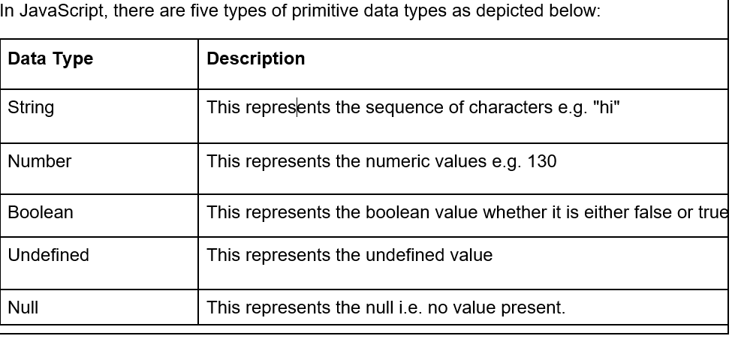
1. Primitive data types in JavaScript

Slide 75
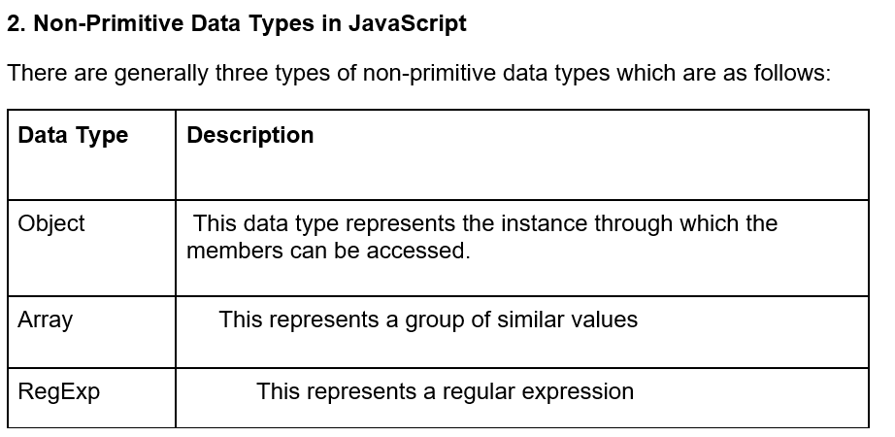

Slide 76
3. Type-casting
Typecasting in JavaScript means converting one data type to another data type i.e., the conversion of a string data type to Boolean or the conversion of an integer data type to string data type. The typecasting in JavaScript is also known as type conversion or type coercion.
Types of conversions
The type casting is of two types in JavaScript. They are the implicit type conversions and the explicit type conversions.
Implicit type casting
The implicit type casting is the conversion of data type done due to the internal requirement or automatic conversion by the compiler or the interpreter.

Slide 77
To understand the implicit conversion let us consider the example of the boolean values (primitive). JavaScript expects a boolean value in a conditional expression. So JavaScript will temporarily convert the value in parentheses to a Boolean to evaluate the if expression
val = 1;
if (val) {
console.log( 'yes, val exists' );
}
Implicit conversion with == operator
Type conversion is also performed when comparing values using the equal (==) and not equal (!=) operators. So when you compare the number 125 with a string '125' using the equals (==) operator, the expression evaluates to true −
console.log( 125 == '125' );

Slide 78
Explicit type casting
The explicit type casting is done forcefully by the developer for the sake of a good line of code. In JavaScript the type casting can be done only for strings, numbers and Boolean (object) data types.
Examples of the explicit type casting are methods parseInt(), parseFloat() and toString().
The parseInt() function converts its first argument to a string, parses that string, then returns an integer or NaN.
The parseFloat() function parses an argument (converting it to a string first if needed) and returns a floating point number.
The toString() method returns a string representing the object, i.e., it tries to convert object to string.

Slide 79
Example
Following example demonstrates explicit type casting in JavaScript.
let a = 1.015
console.log(a)
console.log(typeof a)
console.log(a.toString())
console.log(typeof a.toString())
Output
1.015
number
1.015
String

Slide 80
1.4.2: Use data types in JAVASCRIPT
Primitive data types
Example:
<script>
var x=20;//holding number
var y="Phptpoint";//holding string
var bool=true;//holding boolean true
var bool=false;//holding boolean false
var blank=null;//holding null value
<script>

Slide 81
Non primitive data types
Example of Object:
<script>
//example of Object
stu={id:101,name:"sanjeev"}
alert(stu.id+" "+stu.name);
</script>
Example of Array:
<script>
//example of Array
arr=Array(101,"sanjeev");
alert(arr[0]+" "+arr[1]);
</script>

Slide 82
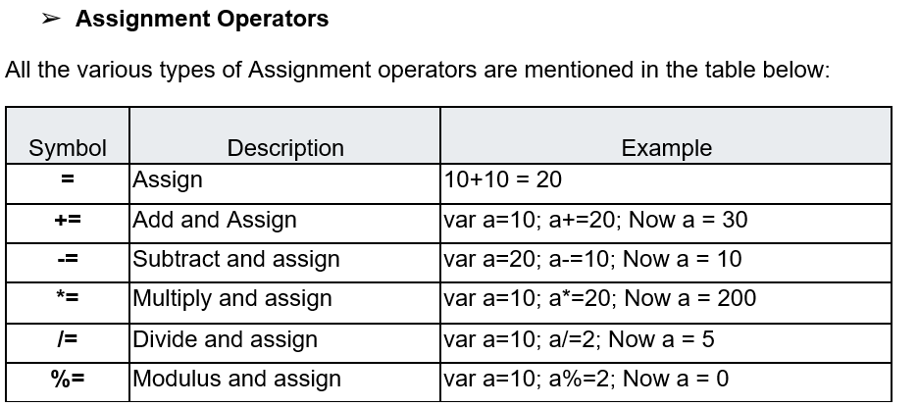
Indicative content 1.5: Use of operators in JavaScript
1.5.1: Describe the operators in JavaScript

Slide 83
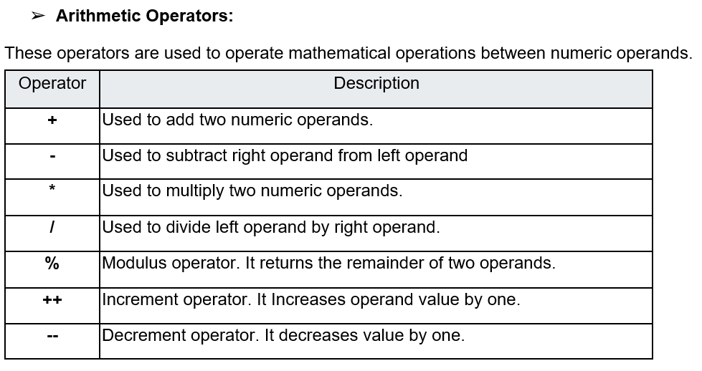

Slide 84
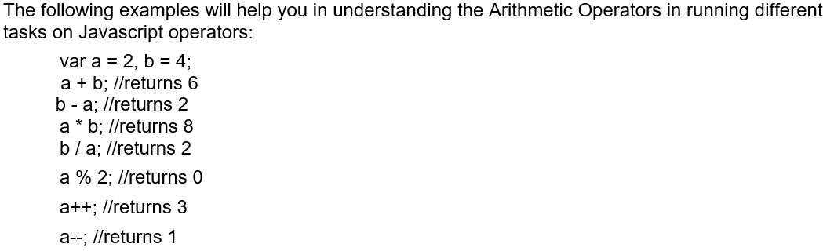

Slide 85
Note: + Operator executes a series of operations provided one of the operands is of string type. This example will help you understand the working of + Operator on operands of various data types.
var w = 5, x = "Hello ", y = "World!", z = 10;
w + x; // "5Hello "
x + y; // "Hello World!"
w + z; // 15

Slide 86
String Operators
A string operator in JavaScript, simply put, is an operator that operates on a string.
There are only two operators that JavaScript supports for modifying a string. These operators allow you to join one string to another easily. These operators are called “concatenate” and “concatenate assignment“.
These two operators allow you to join one string to another.
Concatenate: This refers to appending one string to another.
Concatenate Assignment: Similar to the previous but refers more specifically to appending a string to the end of a variable. Assigning the final result to that variable.

Slide 87
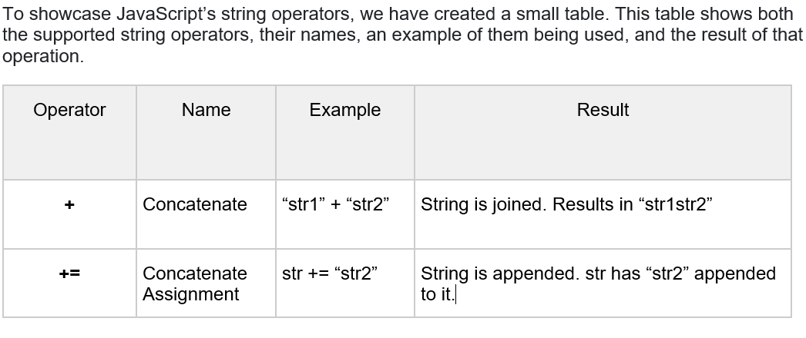

Slide 88
Please note that JavaScript’s string operators will attempt to convert non-strings to a string. The data type that you include must have some way of being converted. For example, JavaScript can easily convert the number 112 to a string.
Comparison Operators
Any time you compare two values in JavaScript, the result is a Boolean true or false value. You have a wide selection of comparison operators to choose from, depending on the kind of test you
want to apply to the two operands. There are basically 4 ways by which the equality is tested that are listed as follows:
'==' operator
'===' operator
SameValuezero: this is mainly used in maps, arrays and sets.
SameValue: these are used elsewhere.

Slide 89
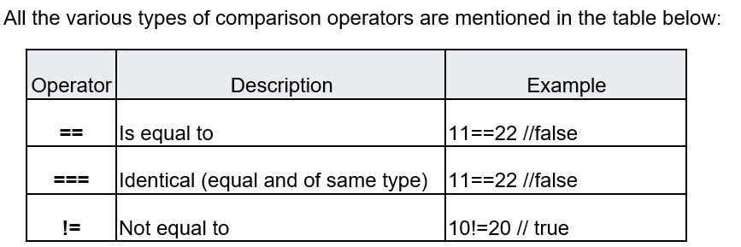

Slide 90
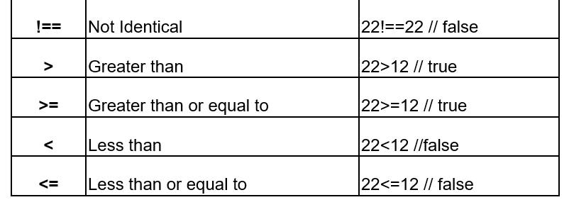

Slide 91
'==' operator:
In javascript, the use of this operator is mainly in comparing two values on both the sides and then returning true or false as a result. This javascript operator evaluates the equality only after converting or we can say bringing both the values to a common type known as type coercion.
For numeric values, the results are the same as those you would expect from your high school algebra class.
10 == 10 // true
10 == 10.0 // true
9 ==10 // false

Slide 92
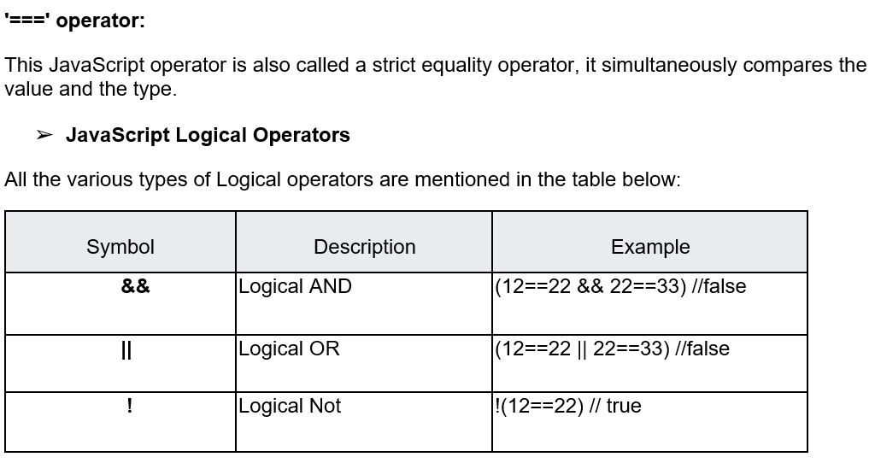

Slide 93
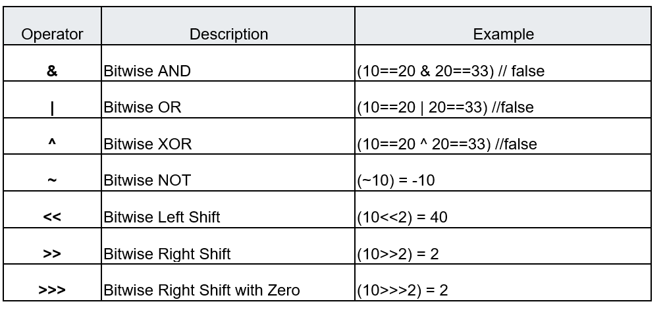
JavaScript Bitwise Operators
The bitwise operator’s carryout bitwise operations on the operands. Here are the bitwise operators:

Slide 94
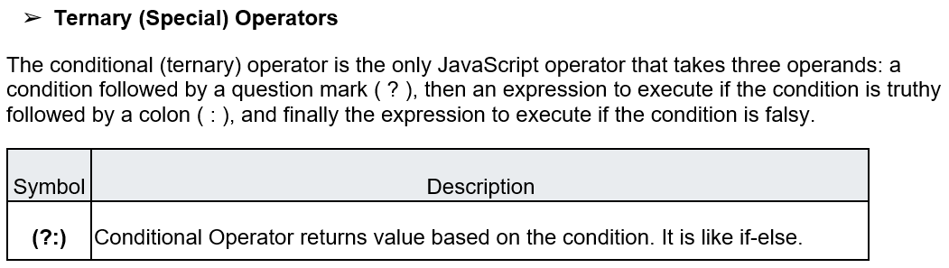

Slide 95
1.5.2: Use the operators in Javascript
✔ Assignment operators
<!DOCTYPE html>
<html>
<body>
<h1>JavaScript Assignments</h1>
<h2>Simple Assignment</h2>
<h3>The = Operator</h3>
<p id="demo"></p>
<script>
let x = 10;
document.getElementById("demo").innerHTML = "Value of x is: " + x;
</script>
</body>
</html>

Slide 96
Output:
JavaScript Assignments
Simple Assignment
The = Operator
Value of x is: 10

Slide 97
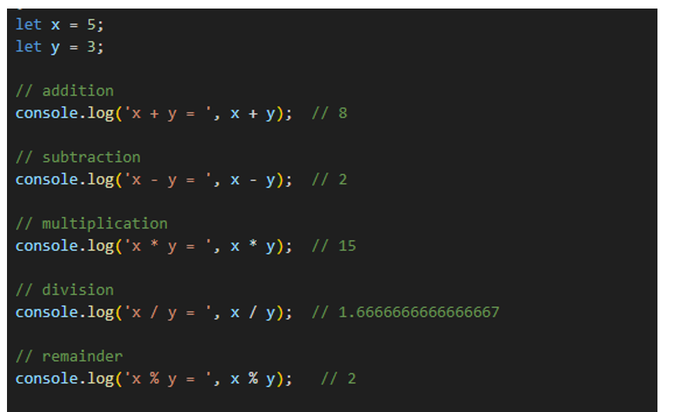
✔ Arithmetic operators
Examples

Slide 98
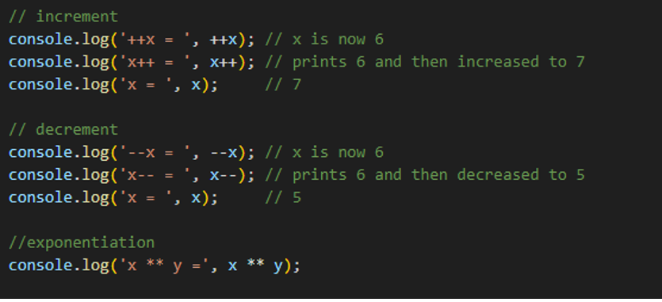

Slide 99
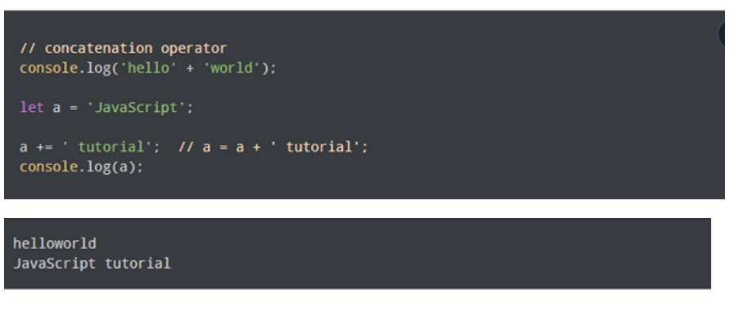
✔ String operator
In JavaScript, you can also use the + operator to concatenate (join) two or more strings
Example :

Slide 100
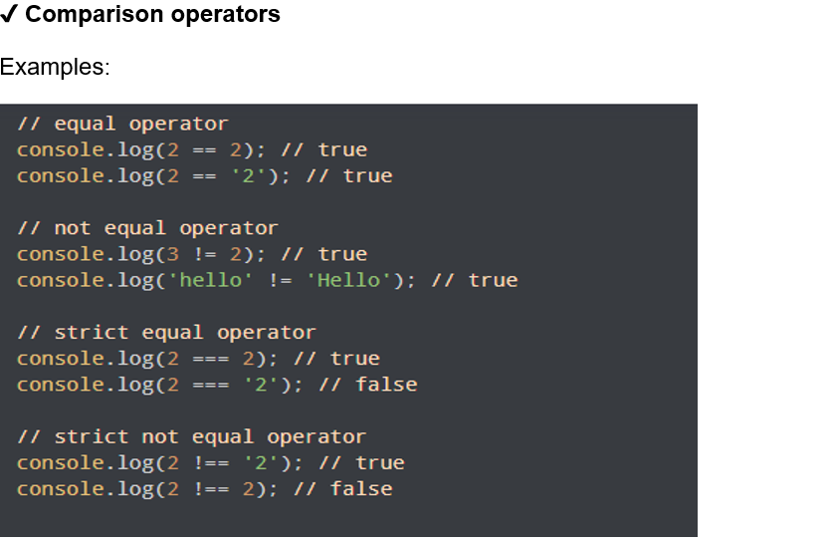

Slide 101
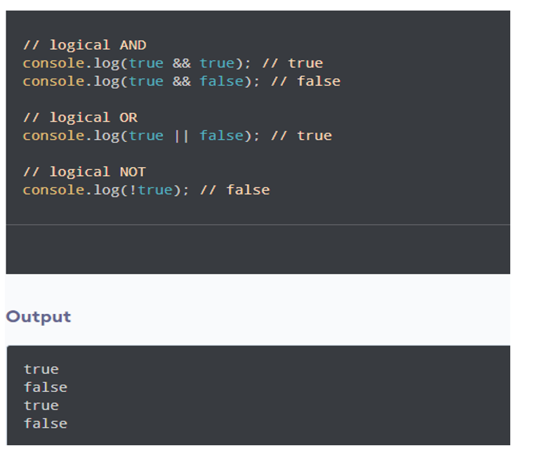
✔ Logical operators
Examples:

Slide 102
CLEVER

